Slide 1
Lecture 9
Android UI Layout & UI Controls

Slide 2
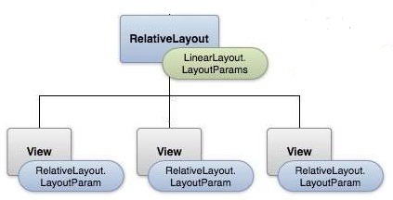
UI Layout
View is the base class for widgets, which are used to create interactive UI components like buttons, text fields, etc.
The ViewGroup is a subclass of View and provides invisible container that hold other Views or other ViewGroups and define their layout properties.

Slide 3
UI Layout
Step 1: Create Layout-XML File and Take Widgets which you want…..
<RelativeLayout
android:layout_width="fill_parent“
android:layout_height="fill_parent”>
<TextView
android:id="@+id/text“
android:layout_width="wrap_content"
android:layout_height="wrap_content“
android:text="This is a TextView" />
<Button
android:id="@+id/button“
android:layout_width="wrap_content"
android:layout_height="wrap_content"
android:text="This is a Button" />
</RelativeLayout>

Slide 4
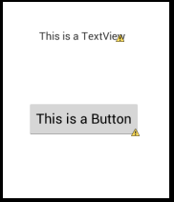
UI Layout
Output of XML File:

Slide 5
UI Layout
Step 2: Link your XML File with Java File…..
Syntax in Java File:-
public void onCreate(Bundle savedInstanceState)
{
super.onCreate(savedInstanceState); setContentView(R.layout.activity_main);
}
Note: You have to use setContentView Function in
OnCreate Method to link your xml file with java file.

Slide 6
UI Layout
Android Layout Types:-
Layout | Description
Linear Layout | LinearLayout is a view group that aligns all children in a single direction, vertically or horizontally.
Relative Layout | RelativeLayout is a view group that displays child views in relative positions.
Table Layout | TableLayout is a view that groups views into rows and columns.
Frame Layout | The FrameLayout is a placeholder on screen that you can use to display a single view.
List View | ListView is a view group that displays a list of scrollable items.
Grid View | GridView is a ViewGroup that displays items in a two-dimensional, scrollable grid.
Absolute Layout | AbsoluteLayout enables you to specify the exact location of its children.

Slide 7
UI Layout
Layout Attributes: Each layout has a set of attributes which define the visual properties of that layout.
Attribute | Description
android:id | This is the ID which uniquely identifies the view.
android:layout_width | This is the width of the layout.
android:layout_height | This is the height of the layout.
android:layout_marginTop | This is the extra space on the top side of the layout.
android:layout_marginBottom | This is the extra space on the bottom side of the layout.
android:layout_marginLeft | This is the extra space on the left side of the layout.
android:layout_marginRight | This is the extra space on the right side of the layout.
android:text | Text to display.
android:textColor | Define Text Color.

Slide 8
UI Layout
Note:
Here width and height are the dimension of the layout/view which can be specified in terms of dp (Density-independent Pixels), sp ( Scale-independent Pixels), pt ( Points which is 1/72 of an inch), px ( Pixels), mm ( Millimeters) and finally in (inches).
You can specify width and height with exact measurements −
android:layout_width=wrap_content : tells your view to size itself to the dimensions required by its content.
android:layout_width=fill_parent: tells your view to become as big as its parent view.

Slide 9
UI Layout
View Identification: A view object may have a unique ID assigned to it which will identify the View uniquely.
Syntax:-
android:id=“@+id/button1”
The at-symbol (@) at the beginning of the string indicates that the XML parser should parse and expand the rest of the ID string and identify it as an ID resource.
The plus-symbol (+) means that this is a new resource name that must be created and added to our resources.
For using this Button in your application, you have to perform 2 basic steps:
Create Object of Button Class by using this syntax: Button btn;
Link id of Button with created object by using this syntax:
btn = (Button)findViewById(R.id.button1);

Slide 10
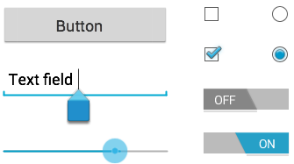
UI Controls
Android provides a wide variety of controls you can use in your UI, such as button, text view, edit text, check box, radio button, Radio Group, Toggle Button, Seek-Bar, Progress Bar, and many more.

Slide 11
UI Controls
Android UI Controls:
UI Control | Description
TextView | This control is used to display text to the user.
EditText | EditText is a predefined subclass of TextView that includes editing capabilities.
AutoCompleteTextView | The AutoCompleteTextView is a view that is similar to EditText, except that it shows a list of completion suggestions automatically while the user is typing.
Button | A push-button with text that can be pressed, or clicked, by the user to perform an action.
ImageButton | A push-button with Image that can be pressed, or clicked, by the user to perform an action.
CheckBox | Use for Multiple Selection.
RadioButton | Use for Single Selection.
RadioGroup | A RadioGroup is used to group together one or more RadioButtons.

Slide 12
UI Controls
Android UI Controls:
UI Controls | Description
ToggleButton | An on/off button with a light indicator.
ProgressBar | ProgressBar provides visual feedback about some ongoing tasks, such as when you are performing a task in the background.
Spinner | A drop-down list that allows users to select one value from a set.
TimePicker | The TimePicker view enables users to select a time of the day, in either 24-hour mode or AM/PM mode.
DatePicker | The DatePicker view enables users to select a date of the day.
SeekBar | A SeekBar is an extension of ProgressBar that adds a draggable thumb. The user can touch the thumb and drag left or right to set the current progress level

